Slide 1
Parallel Connected Components
The Parallelepipeds:
Fabian Meier
Gustavo Segovia
Seraiah Walter

Slide 2
Our goal
Develop a high performance algorithm for connected components
Graph fits in memory

Slide 3
Our goal
Develop a high performance algorithm for connected components
Graph fits in memory

Slide 4
Algorithms – Related work
Basic serial
Traversal (BFS/DFS) – O(n + m)
Union find – O(m log(n))
Boost
Serial
Parallel
Randomized Contraction Parallel Connected Components
http://www3.cs.stonybrook.edu/~rezaul/Spring-2012/CSE613/CSE613-lecture-11.pdf

Slide 5
Algorithms – Ours
Lock free parallel traversal
Parallel BFS
Parallel BFS with atomics
Parallel spanning tree – inspired by union find

Slide 6
Algorithm details

Slide 7
Serial traversal
Unmarked vertices

Slide 8
Serial traversal
Algorithm starts at one vertex

Slide 9
Serial traversal
And transverses all connected vertices

Slide 10
Serial traversal
Continues to next unmarked vertex

Slide 11
Serial traversal
And marks each component

Slide 12
Serial traversal

Slide 13
Union find

Slide 14
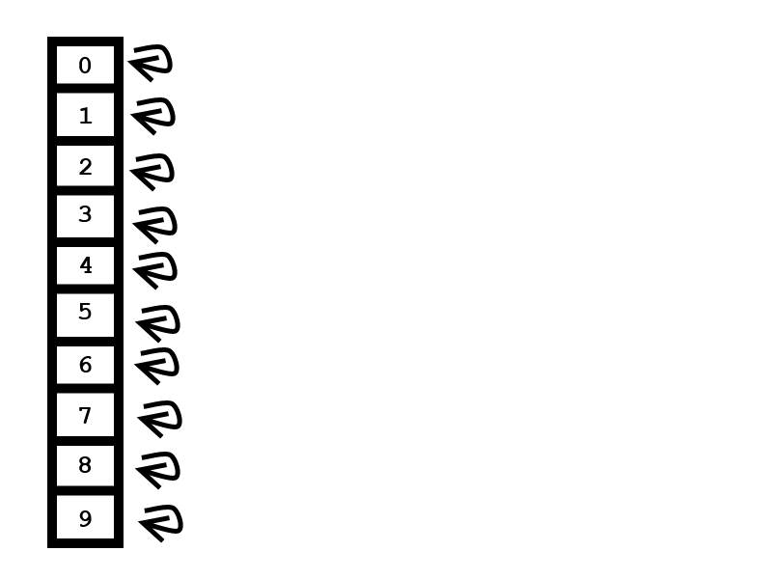
Union Find

Slide 15
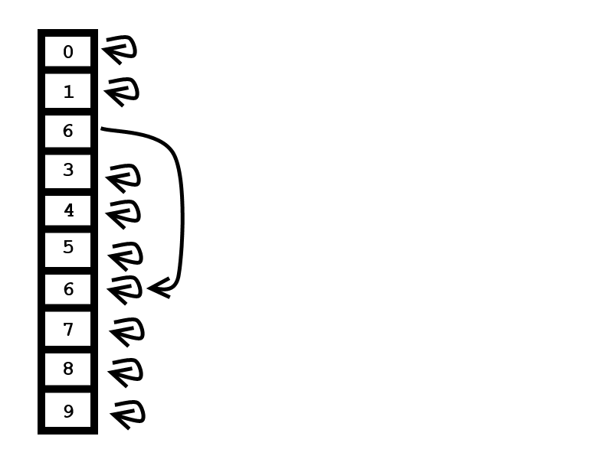
Union Find
edge 2-6

Slide 16
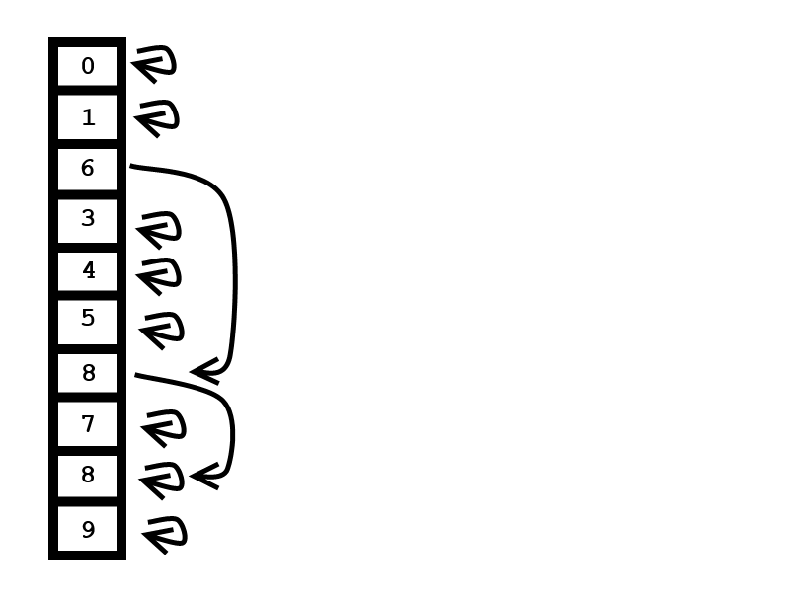
Union Find
edge 2-6
edge 2-8

Slide 17
Union find

Slide 18
Parallel spanning tree

Slide 19
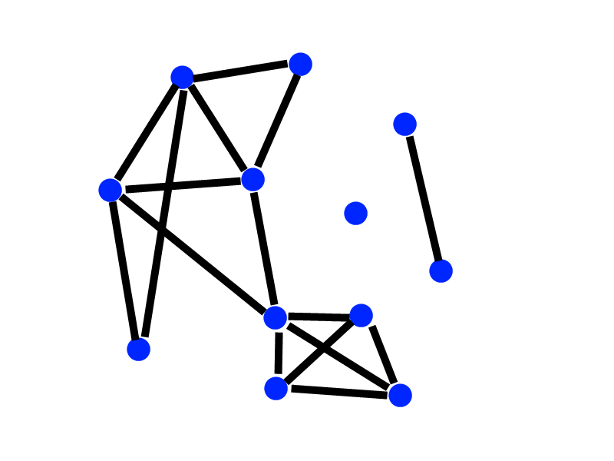
Parallel spanning tree

Slide 20
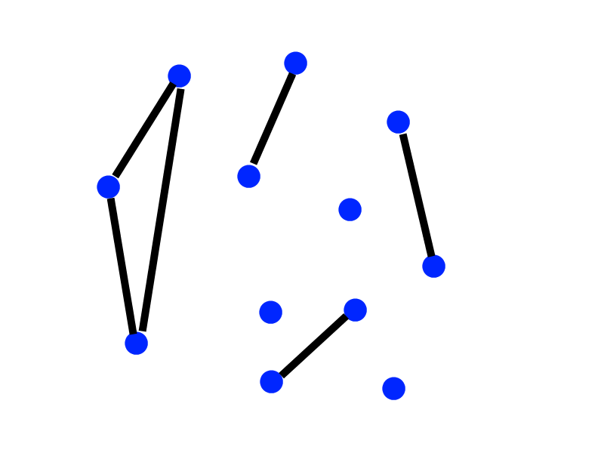
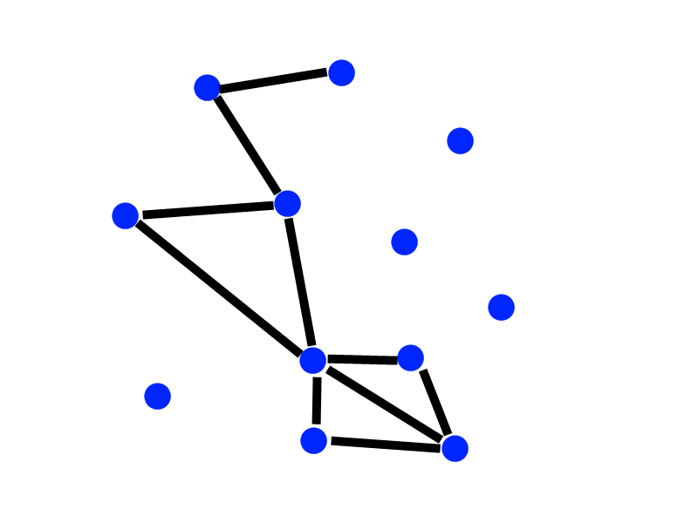
Parallel spanning tree

Slide 21
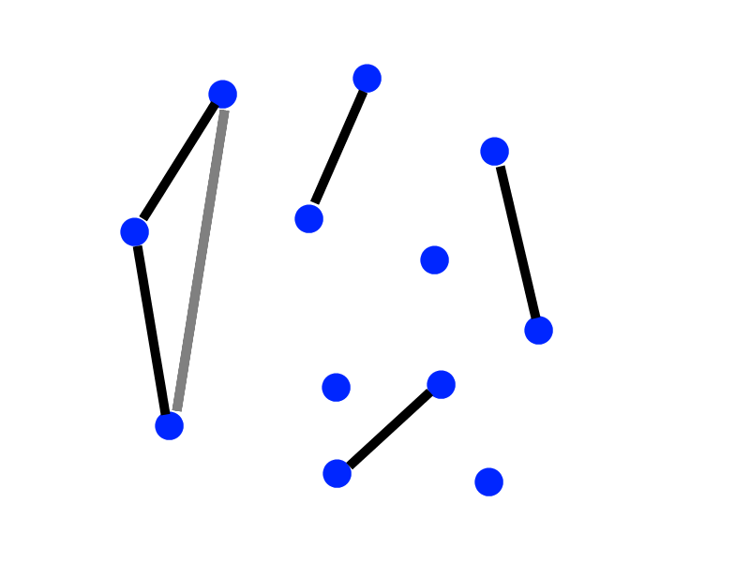
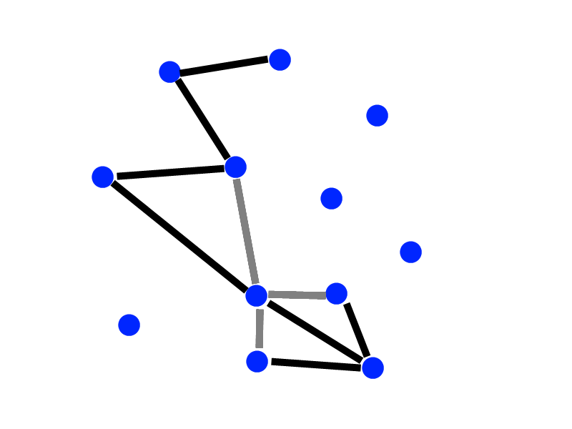
Parallel spanning tree

Slide 22
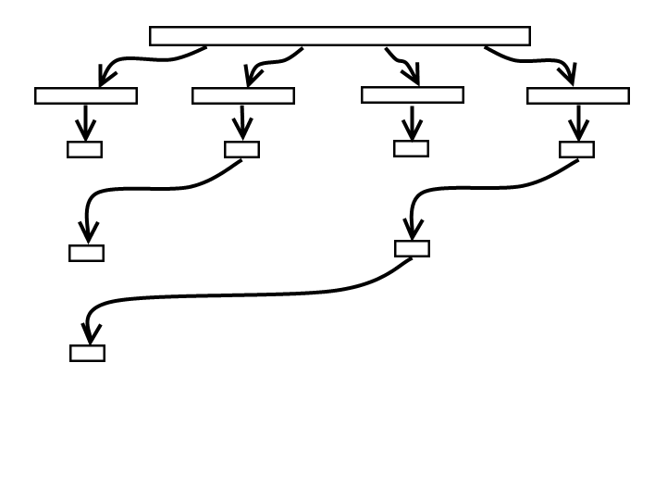
Parallel spanning tree
Runtime: O(m/p+ n*log(p))
Strong scaling in number of processors

Slide 23
Randomized contraction

Slide 24
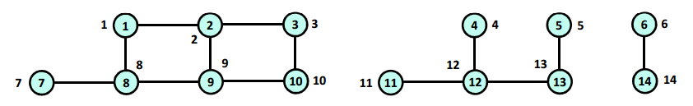
Randomized contraction
source: http://www3.cs.stonybrook.edu/~rezaul/Spring-2012/CSE613/CSE613-lecture-11.pdf

Slide 25
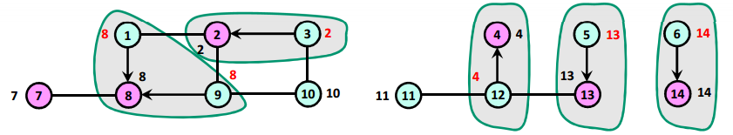
Randomized contraction
Each vertex is given a random color (pink / light blue)
source: http://www3.cs.stonybrook.edu/~rezaul/Spring-2012/CSE613/CSE613-lecture-11.pdf
Notes:
Every edge between blue to pink is contracted.

Slide 26
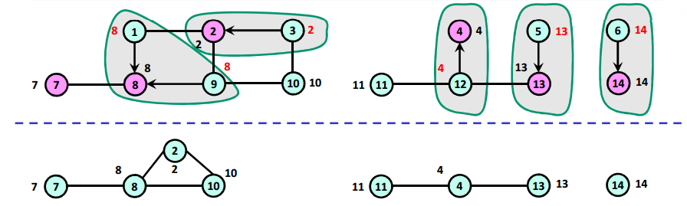
Randomized contraction
Each contraction leads to less edges
source: http://www3.cs.stonybrook.edu/~rezaul/Spring-2012/CSE613/CSE613-lecture-11.pdf

Slide 27
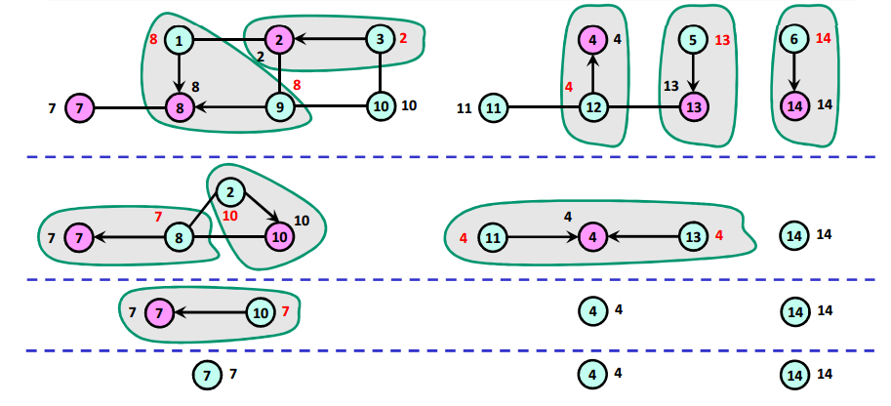
Randomized contraction
Contract until no edges are left
source: http://www3.cs.stonybrook.edu/~rezaul/Spring-2012/CSE613/CSE613-lecture-11.pdf

Slide 28
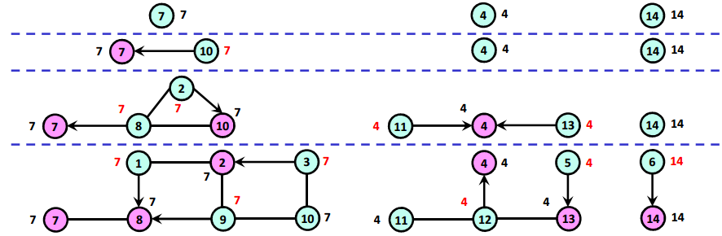
Randomized contraction
Reverse the path to find the vertices component number
source: http://www3.cs.stonybrook.edu/~rezaul/Spring-2012/CSE613/CSE613-lecture-11.pdf

Slide 29
Randomized contraction
Notes:
Parallel version, simply splits edges and vertices to each thread
Does not perform well. Simply does more operations and is not linear time

Slide 30
Parallel traversal

Slide 31
Parallel traversal
Unmarked vertices

Slide 32
Parallel traversal
Each thread starts at a vertex

Slide 33
Parallel traversal
Vertices are marked
When one thread hits a component marked by another thread, it makes an entry in the merge table

Slide 34
Parallel traversal
Vertices components are merged

Slide 35
Parallel traversal
Problem, thread might not notice it is marking a vertex that was already marked by another thread

Slide 36
Parallel traversal
Problem, thread might not notice it is marking a vertex that was already marked by another thread
Green thread
Yellow thread
Step 1
Step 1

Slide 37
Parallel traversal
Problem, thread might not notice it is marking a vertex that was already marked by another thread
Green thread
Yellow thread
Step 1
Step 1
Step 2

Slide 38
Parallel traversal
Problem, thread might not notice it is marking a vertex that was already marked by another thread
Green thread
Yellow thread
Step 1
Step 1
Step 2
Step 3

Slide 39
Parallel traversal
Problem, thread might not notice it is marking a vertex that was already marked by another thread
Green thread
Yellow thread
Step 1
Step 1
Step 2
Step 2
Step 3
Step 3

Slide 40
Parallel traversal
Problem, thread might not notice it is marking a vertex that was already marked by another thread
Green thread
Yellow thread
Step 1
Step 1
Step 2
Step 2
Step 3
Step 3
Possible result:
(with no merge table entry!)

Slide 41
Parallel traversal
Solution 1: check if algorithm output is correct. If not, run again with 1 thread
Fast to check
Problem is very unlikely. Slow execution is amortized

Slide 42
Parallel traversal
Notes:
Benefit kicks in at about 100 thousand vertices
About 10x speed up at 1 million

Slide 43
Parallel traversal with atomics
Solution 2: Use test and set (atomic_flag)
Every time a thread marks a vertex, it makes sure no other thread marked it before with test and set
Each vertex has is own atomic_flag

Slide 44
Parallel traversal with atomics
Notes:
Atomic performs a bit worse

Slide 45
Algorithm results

Slide 46
Runtime varying the number of vertices
Notes:
Parallel bfs and atomic parallel bfs are winning, followed close behind by serial union find

Slide 47
Memory usage varying the number of vertices
Notes:
Bfs/pbfs/atomicbfs create adjacency list
Boost does too, but it is absurdly big
Ufind works directly with input, so graph is a bit biased

Slide 48
Runtime varying the number of components
Notes:
Algorithms that depend more on the number of edges are favored like union find, randomized contraction and parallel randomized contraction.
Other stay stable

Slide 49
Runtime varying the number of threads
Notes:
Serial algos shown as straight lines
Runtime is best at around 30-40 cores

Slide 50
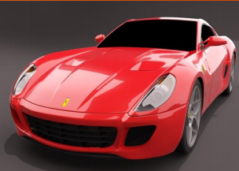
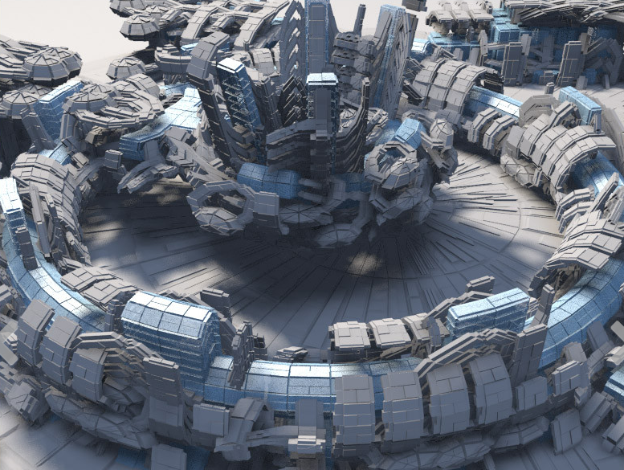
Runtime on real world graphs
~350 thousand vertices
~700 thousand edges
753 components
~1.2 million vertices
~2.4 million edges
6617 components
Notes:
Program developed to convert .obj files
Number components checked with program called trimesh2, programming used for processing meshes

Slide 51


Runtime on real world graphs
608 vertices
1216 edges
1 component
~10 thousand vertices
~31 thousand edges
135 components
Notes:
Program developed to convert .obj files
Number components checked with program called trimesh2, programming used for processing meshes

Slide 52
Conclusions and lessons learned
Different algorithms are right for different situations
Best overall: union find (even though traversal has better complexity)
Best for very large graphs and plenty of cores: parallel traversal with atomics
Should use algorithm that matches graph datastructure (not worth the time switching)
Extra threads can help runtime up to a limit
Boost is very bloated in terms of memory and not difficult to beat in runtime
It is not a good idea to take measurements on a shared Xeon phi on the weekend before final presentation (5 hour queue)

Slide 53
Thank you

